Slide 1
Energy Explorer
Team: Spam W
Veevek Dave, Mei Huang, Yash Choksey,
Rashona Yang, Oluwapamilerin Amuda
Notes:
R

Slide 2

Updates On
Energy Explorer is a website that aims to reduce the barrier of entry for community science in renewable energy sources.
Notes:
it focuses on what renewable energy sources are viable(?) for different regions
Employ data visualization -maps
Efficient User Friendly Design
Usability as a main focus

Slide 3
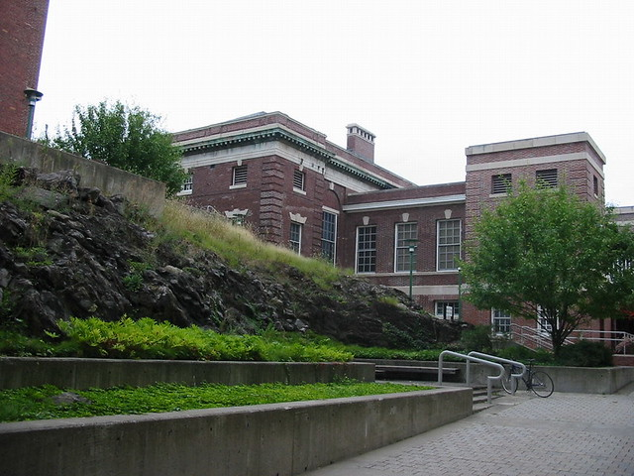
Research/Changes In Scope
We met with the data science class from last semester to confirm the scope of the data.
Scope of the group differed from their statement so we had to pivot to a different groups dataset.
Notes:
Met with ayanna
Talked about the scope of the data
Decided to reduce our scope to wind, water, solar, geothermal

Slide 4


Addressing previous concerns
Visualization: and Liscening documentation http://oceansofdata.org/sites/oceansofdata.org/files/Visualizing-Oceans-Data-Report-Dec2013.pdf
Addressing Accessibility: 508 Compliance https://www.section508.gov/manage/laws-and-policies/
Section508.gov
Notes:
508 Topics such as
Language,
Resizable Text,
Links and Buttons,
Images

Slide 5
What have we been up to?
Feb 1
Feb 12
Feb 26
Feb 5
Feb 19
Created Common Page Components
Redefinition of scope & Data set use
Wireframes & Presentation Topics Research
Research on how to access data
Finished Front-End
Notes:
R
-as mentioned, we’ve made significant(?) progress on the project
-spread it in a timeline view marked by our 2-hr weekly meetings (went over previously assigned tasks; reviewed and merged code; assigned next tasks)
-after the proposal, we redefined the scope and the data being used; we researched how to access this data and created page components and finished our frontend as of feb 26

Slide 6
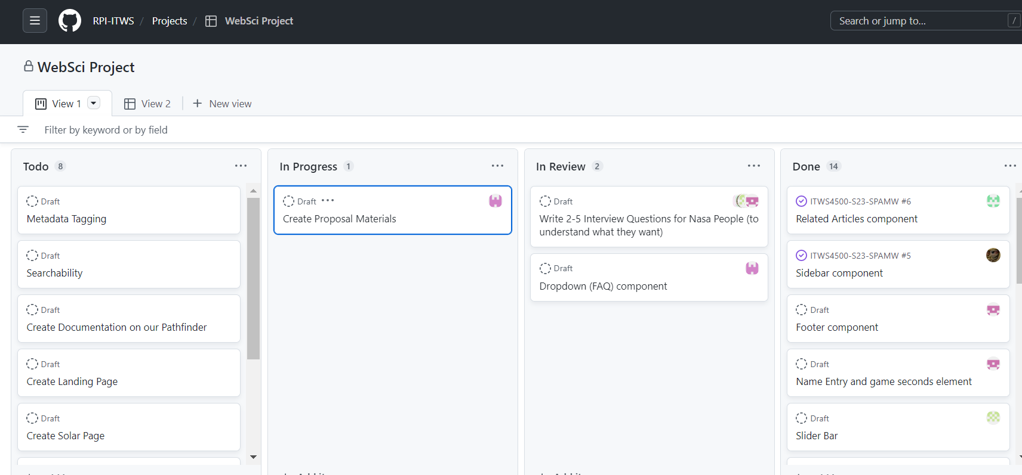
Github Project Board
Notes:
R
-agile method, weekly sprints
-our team is organized, we take this very seriously (for the success of the project)
-these weekly meetings accomplished a lot in a short period of time, so we kept each other accountable and on track using Github Project board
-snapshot of what it looked like a few weeks ago
-in addition, using discord to share resources amongst ourselves and for quick communication online if we weren’t able to meet in person

Slide 7
Here’s what you have to look forward to.
Mar 12
Apr 9
Mar 26
Apr 16
Final Presentation Prep for the 21st
Data Visualization
Mongo DB
Final Bug Fixing/Site Finalization
Notes:
Currently right now the main focus over spring break is to do preliminary research on MongoDB and try learn as much as possible.
We also plan on working over simple frontend fixes and improvement to make the website better looking
Next is beginning to add Data Visualization using graphs, barcharts and mas to better emphasize our points
We will consider accessibility options when making our data visualizations.
Bug fixes will come at the tailend of the project cycle, to reduce missing out potential bugs.

Slide 8
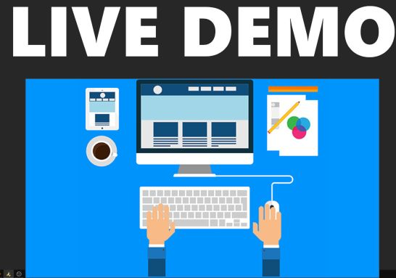
Notes:
Mei-Landing page hello everyone, for the purpose of this demo, i will be going through the site from the perspective of community scientist, Joe. so, let's say I'm joe, and I want to know the distribution of solar energy by location. To do that, I will visit this website. The first thing I'll see is the clear mission statement, so i know have come to the right place. Luckly for me, it's easy for me to find where everything is due to the clear layout. I see want to get some nasa data on solar enegy, i see that there's search icon. if i i click on it, i can search for what i want. let's say, i don't know what format the data come in, i can check the faq on the side to learn that i can download it in json and csv. I can click on the solar link since that what's interested in learning.
Veevek-Solar page

Slide 9
Thank you
Questions?
SPAMW

